Slide 1
API’s and Database Connectors
Class 5

Slide 2
Agenda
What’s an API?
httr package & jsonlite
Database Connectors
Dbi & odbc

Slide 3
What’s an Api
Eh?

Slide 4
API’s
Application Programming Interface
There are many kinds of API’s
Web service
SOAP, XML-RPC, JSON-RPC, and REST
WebSocket
Library-based
Class-based
OS functions and routines
Object remoting
Hardware

Slide 5
REST API’s
End points - different URL’s that tell the webserver what data you would like
It’s essentially a website where you request different “end points”
There are 5 types of Requests you can make
GET (what we will use the most in this course)
POST (sometimes necessary for authentication, if you’re trying to write data somewhere)
PUT
PATCH
DELETE

Slide 6
Errors
Status codes indicate the result of the HTTP request.
100’s - info
200’s - success
300’s - redirection
400’s - client error (you messed up)
500 ’s- server error (something went wrong on their end, but you still could have messed up)

Slide 7
Httr & jsonlite

Slide 8
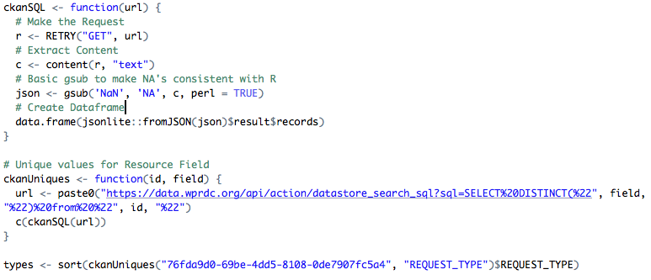
A simple GET request

Slide 9
Practice

Slide 10
DBI

Slide 11
Database Connectors
First install a unixodbc driver manager
Then you have to install the correct ODBC driver
This will depend on the kind of database you are connecting to
IE: Microsoft SQL Server you can install the FreeTDS driver
Follow the directions carefully
Then you need to install the odbc and DBI r packages

Slide 12
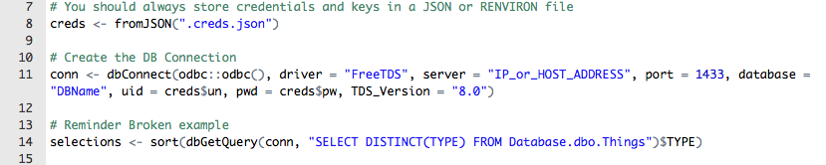
Example

Slide 13
Recommended Reading
API: https://medium.freecodecamp.org/what-is-an-api-in-english-please-b880a3214a82
httr: https://cran.r-project.org/web/packages/httr/vignettes/quickstart.html
WPRDC API Documentation: http://docs.ckan.org/en/latest/api/index.html
DBI: https://db.rstudio.com/dbi/

